Slide 1
BMI 217
Prognostics theme

Slide 2
What is prognostics?
Prognosis is the long term effect of disease on a patient
How the patient responded to therapy ..
Can be the time the patient recurred or relapsed
Can be time the patient died after diagnosis
Encoded in different ways
Survival: death vs. alive at a specific time inteval after diagnosis (e.g. after 5 years).
Binary outcome
Therapy response:
E.g. Pathologic complete response (pCR), partial response, stable disease etc.
Binary outcome or multicategorical
Time to event survival
Event can be anything: relapse, death, recurrence etc.
Event can be censored: event not recorded patient was alive at last possible time
Requires specific statistical models to deal with censoring

Slide 3
Why prognostics?
Give information to the patient about disease outcome
Availability of high throughput high dimensional data
Change treatment
Intensify treatment for poor prognosis patients
Wait-and-see approach for good prognosis patients
*
Most applications in the prognostics theme will be drawn from oncology
*
See next slide

Slide 4
Data availability
Prognostics used to be based on physician’s interpretation of medical record
Very limited
Based on physician’s experience and similar patients
Data poor
Electronic medical record:
Digitized data
Text mining
Technological evolution has unleashed a data tsunami
Biological sample assays: microarray technology (1999), sequencing (2010), proteomics
Blood based assays: protein measurements, circulating DNA, etc.
Quantitative medical imaging

Slide 5
Data availability continued
Common theme of this evolution
High throughput data
High dimensional data (1000s of variables/parameters measured per patient)
Impossible to interpret directly by physician
Need for data mining/machine learning approach to extract patterns from data
Unsupervised and supervised analysis
Popular classifiers are
Support vector machines
Bayesian methods
Linear regression with regularization
Decision trees/random forests

Slide 6
Early examples
Breast cancer (van ‘t veer et al. Nature 2002)
Predicting outcome of breast cancer patients using gene expression produced by microarray technology
70 gene signature
Validated in Follow-up paper
Signature of 70 genes to predict breast cancer prognosis
Some issues with validation due to overlap of training & testing

Slide 7
Prognostic gene signatures
Many signatures were discovered for many diseases
Unique signature most likely does not exist
Databases of signatures
MSigDB
GeneSigDB
Signatures have additional use case
Used for gene set enrichment analysis for other studies

Slide 8
Evaluation of prognostics models
Challenge of high dimensional data
Overfitting
Curse of dimensionality
Systematic noise in data
Need rigorous preprocessing strategy
Signal to noise of high throughput biological data is low
Batch correction to eliminate technical effects on parameters
Need rigorous validation strategy
Cross validation (leave on out, 10-fold)
Randomization strategy
Need for independent test set to assess local biases in
Ethnicity
Population bias
Handling of samples
Etc.

Slide 9
Data fusion for prognostics
Combining multiple data sets to improve a learning task
Exploiting potential synergy of multiple data modalities
Increasing availability of multi-modal/multi-scale data sets in the public domain
Notes:
And everything in between

Slide 10
Why Multi-modal? omics revolution
Many omics representing different levels of molecular biology
Genome: copy number, mutation, translocation
Transcriptome: gene expression, microRNA expression
Methylome: DNA methylation, histone methylation
Proteome: protein expression
Rapidly profiled using genome wide technologies
microarray, sequencing, mass spectrometry
Notes:
And this hasn’t changed appreciably over the past 15 years.
With adv in bio, more eff is put into mbpm. In order to know which mbpm to use, it requires invasive biopsy.
Biopsy not only risky, but also samples only small portions.
doesn’t completely charac molecular profiles of tumors or their functional and physiological properties, such as size, location, vascularity, metabolic state, etc.

Slide 11
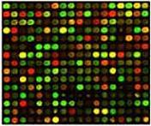
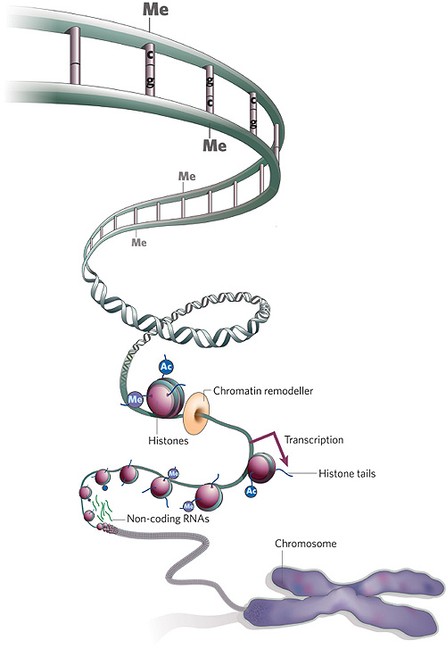
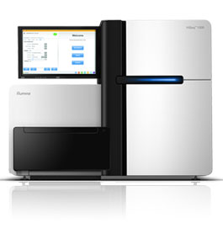
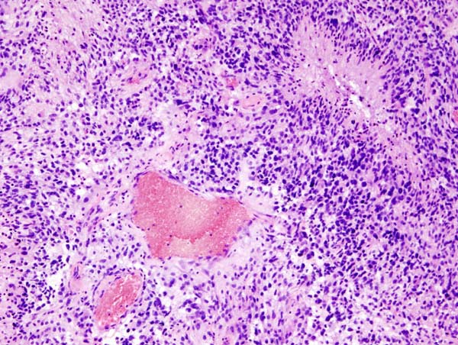
Example: The Cancer genome atlas (TCGA)
Gene expression
microRNA expression
Copy number
DNA methylation
DNA mutation
Pathology images
Medical Images

Slide 12
Summary prognostics theme
Overview of data types used to predict prognosis
Gene signatures: uniqueness, databases and other uses
Focus on supervised modeling and use of classifiers
Eliminating biases of data: batch correction
Statistical modeling of survival outcomes: cox proportional hazard modeling
Data fusion

